Slide 1
Biomedical Imaging

Slide 2
Biomedical Imaging
Image Denoising
Image Segmentation
Content Based Image Retrieval

Slide 3
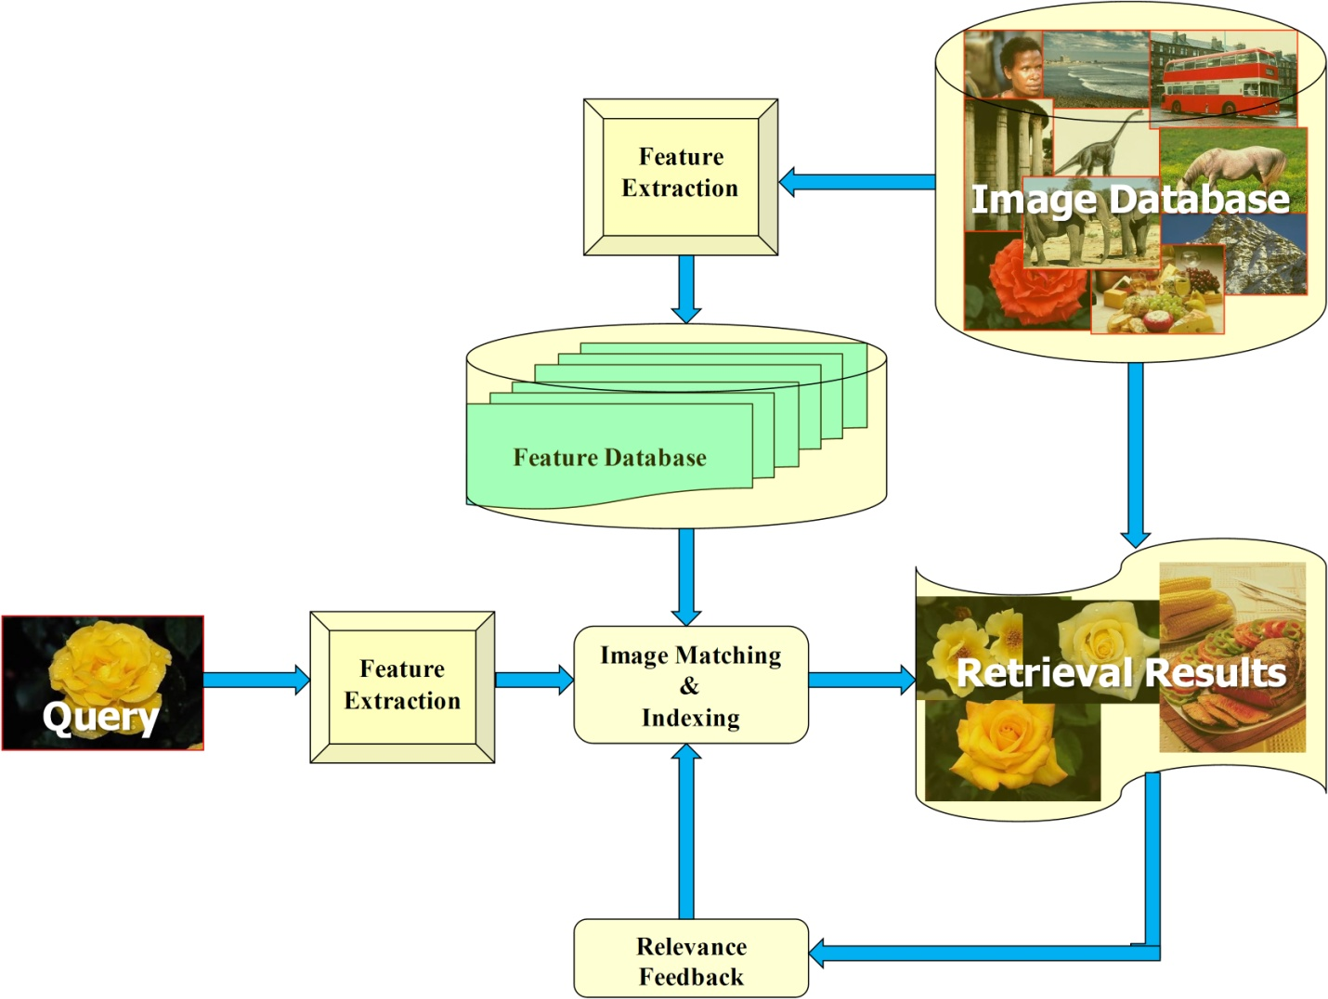
Content Based Image Retrieval
Fig. : General scheme of content based image retrieval

Slide 4
publication
Directional Binary Wavelet Patterns for Biomedical Image Indexing and Retrieval
R. Balasubramanian
Subrahmanyam M
R. P. Maheshwari
J Med Syst
DOI 10.1007/s10916-011-9764-4

Slide 5
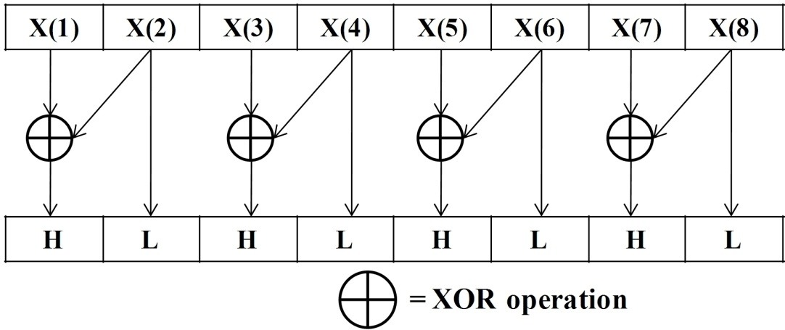
BINARY WAVELET TRANSFORM
Table : Binary wavelet filters grouping of length being equal to 8
Group | Lowpass filter | Highpass filter
1 | {0, 1, 0, 0, 0, 0, 0 ,0} | {1, 1, 0, 0, 0, 0, 0 ,0}
2 | {1, 1, 1, 0, 0, 0, 0 ,0} | {1, 1, 0, 0, 0, 0, 0 ,0}
3 | {1, 1, 1, 1, 0, 0, 0 ,1} | {1, 1, 0, 0, 0, 0, 0 ,0}
4 | {1, 1, 1, 1, 1, 1, 1 ,0} | {1, 1, 0, 0, 0, 0, 0 ,0}
Fig. : In-place implementation of BWT for Group 1 filter

Slide 6
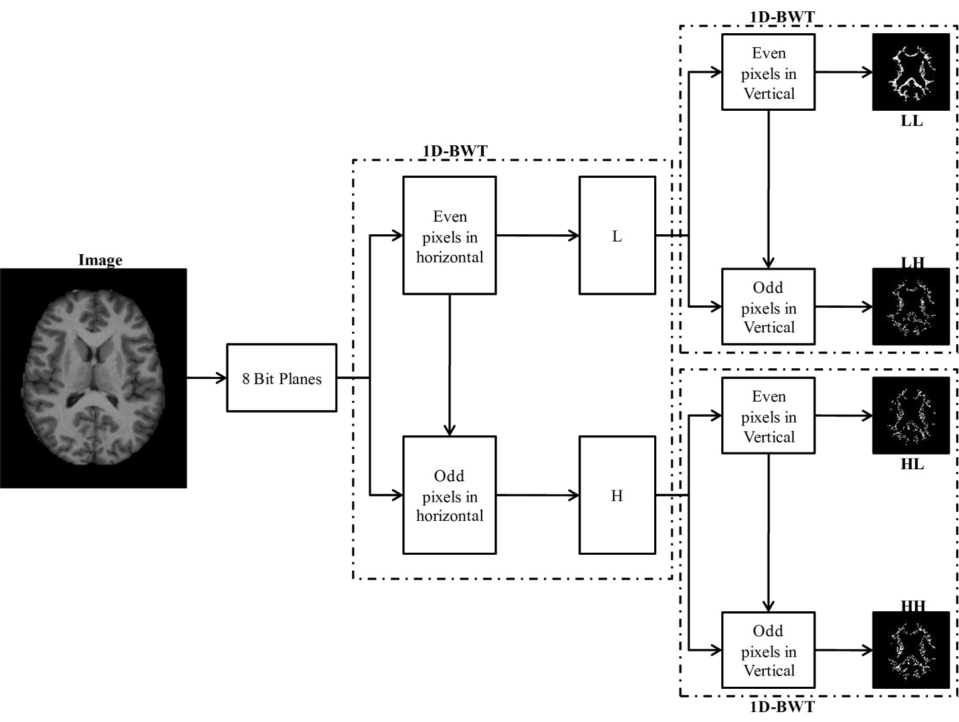
2-D Binary Wavelet Transform (2-D BWT)
Fig. : 2D separable BWT implementation

Slide 7
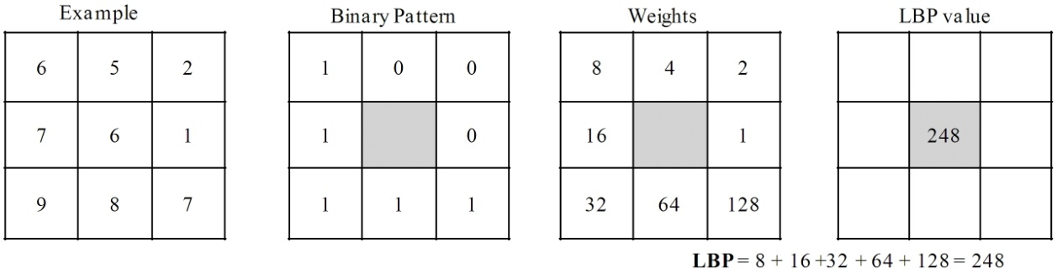
Local Binary Patterns (LBP)
Fig. : Example of obtaining LBP for the 3×3 pattern

Slide 8
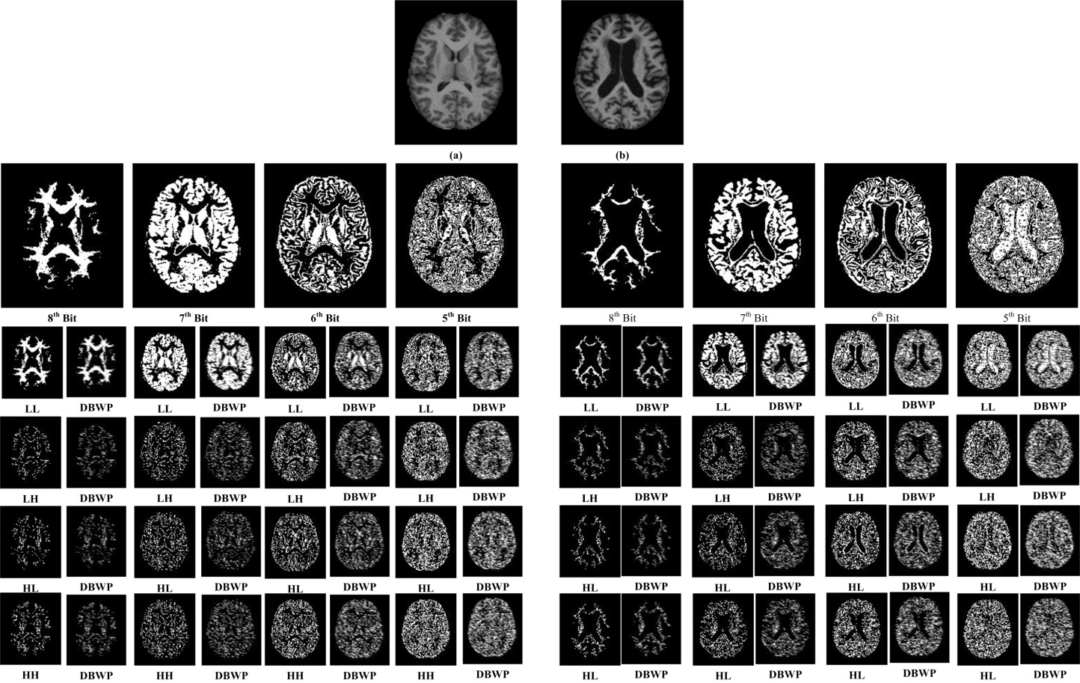
Fig. : Example of obtaining bit planes, BWT sub-bands and DBWP coding for the given two images (a) and (b)

Slide 9
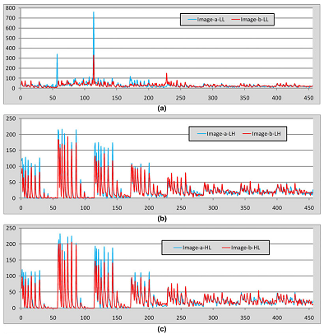
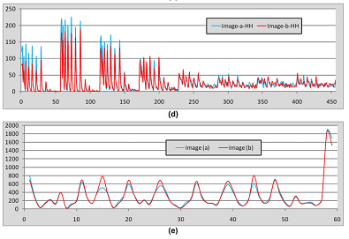
Why our method is better than existing lbp?
Fig. : The features of sample images are calculated and compared each other (a) DBWP of LL sub-band, (b) DBWP of LH sub-band, (c) DBWP of HL sub-band, (d) DBWP of HH sub-band and (e) LBP

Slide 10
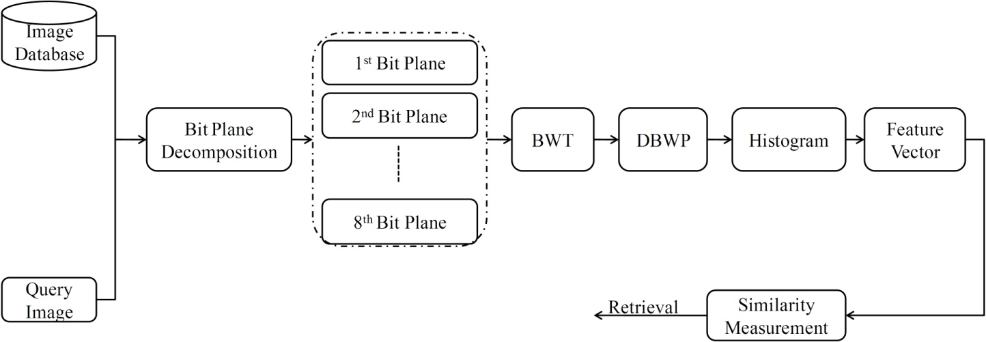
Proposed CBRI System
Fig. : Proposed retrieval system framework for image retrieval

Slide 11
Algorithm
Input: Image; Output: Retrieval result
Load the grayscale image.
Separate the 8-bit planes from the gray image.
Perform the BWT on each bit plane.
Construct the DBWP histograms for all BWT sub-bands.
Construct the feature vector by concatenating all histograms.
Compare the query image with the image in the database using Eq. (13).
Retrieve the images based on the best matches.

Slide 12
RESULTS AND DISCUSSIONS
Image Databases
The Open Access Series of Imaging Studies (OASIS) : MRI dataset
National Electrical Manufacturers Association (NEMA) : CT scan dataset

Slide 13
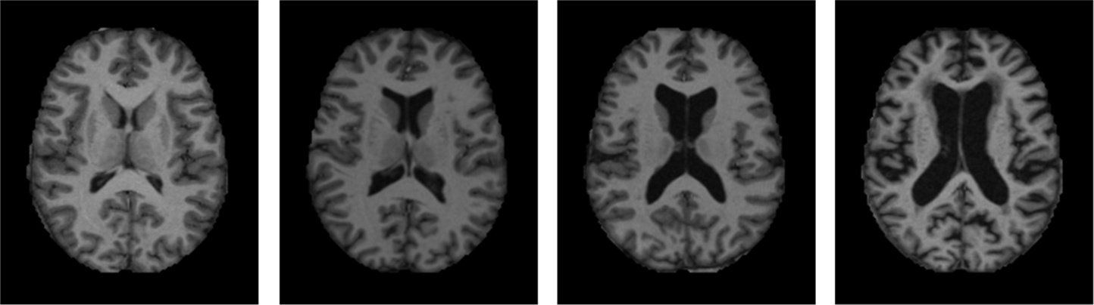
OASIS database
Fig. : Sample images from OASIS database (one image per category)

Slide 14
Table : MRI data acquisition details
Sequence | MP-RAGE
TR (msec) | 9.7
TE (msec) | 4.0
Flip angle (o) | 10
TI (msec) | 20
TD (msec) | 200
Orientation | Sagittal
Thickness, gap (mm) | 1.25, 0
Resolution (pixels) | 176×208

Slide 15
Results
Table : Results of all techniques in terms of Precision on OASIS Database
 |  | Precision (%) (n=10)
 | Group 1 | Group 2 | Group 3 | Group 4 | Total
LBP_8_1 | 51.77 | 32.54 | 33.82 | 49.06 | 42.63
LBP_16_2 | 52.58 | 38.43 | 31.68 | 51.13 | 44.37
LBP_24_3 | 45.88 | 42.64 | 33.70 | 49.53 | 43.44
GLBP_8_1 | 54.43 | 37.94 | 26.51 | 46.03 | 42.42
GLBP_16_2 | 61.12 | 41.17 | 29.43 | 48.11 | 46.31
GLBP_24_3 | 72.01 | 31.37 | 32.36 | 47.83 | 47.69
DBWP_8_1 | 52.74 | 37.74 | 34.38 | 60.00 | 47.05
DBWP_16_2 | 57.74 | 34.70 | 30.78 | 66.69 | 48.71
DBWP_24_3 | 52.98 | 37.15 | 37.42 | 71.79 | 50.59
n —Number of top matches considered

Slide 16
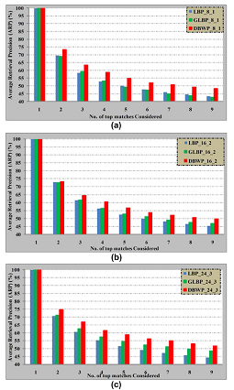
Fig. : Comparison of proposed method (DBWP) with the other existing methods as a function of number of top matches considered on OASIS database

Slide 17
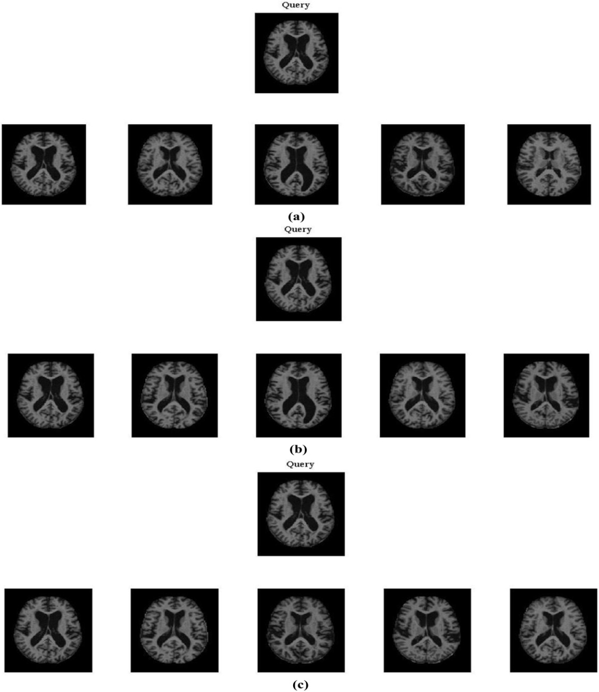
Fig. : Retrieval results of proposed method: (a) DBWP_8_1, (b) DBWP_16_2 and (c) DBWP_24_3.

Slide 18
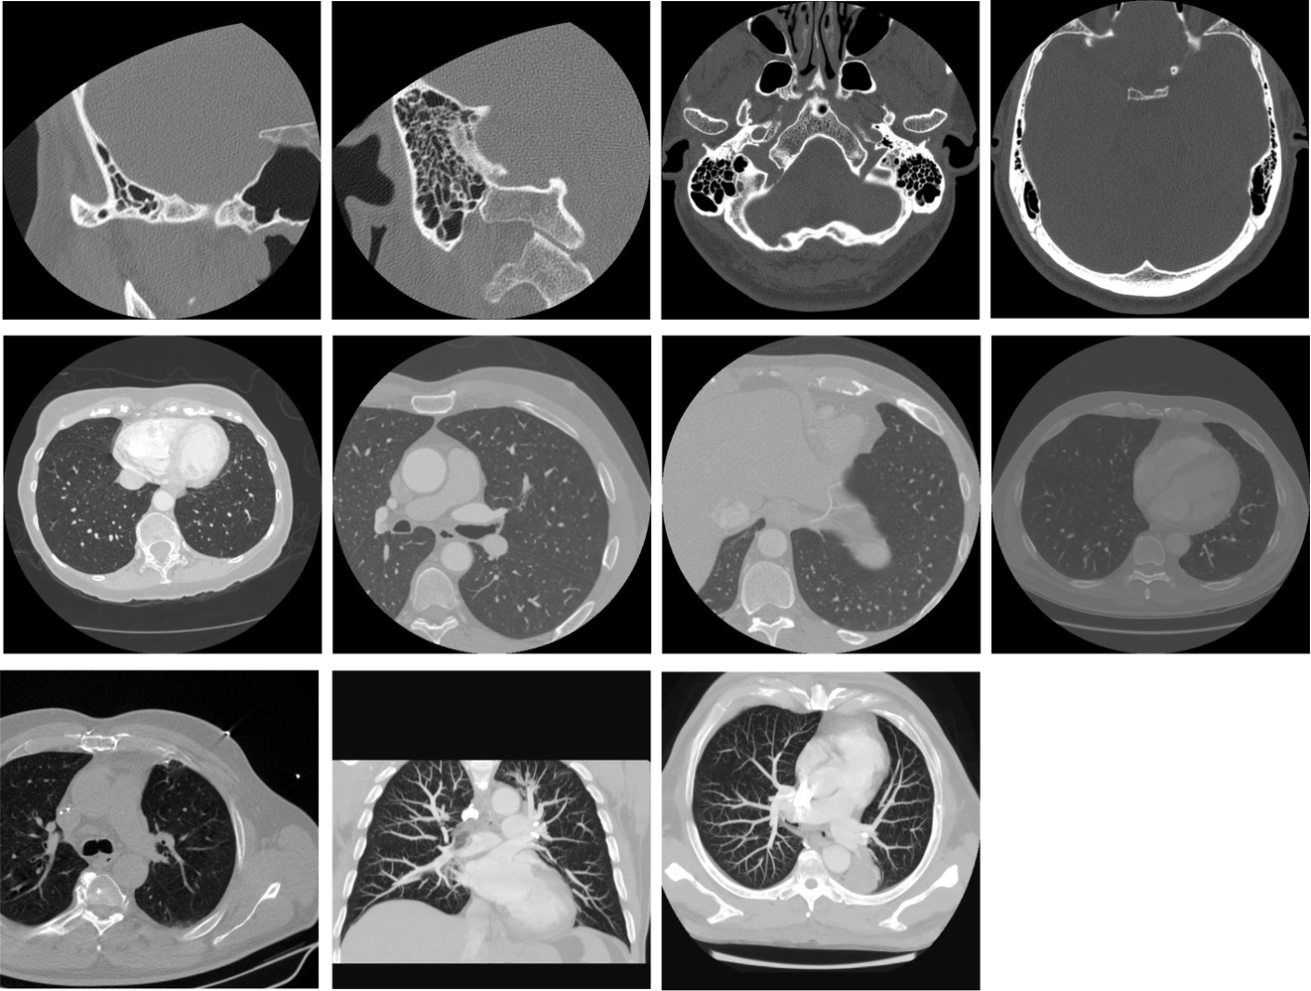
NEMA database
Fig. : Sample images from NEMA database (one image per category)

Slide 19
Table : Data acquisition details of NEMA–CT image database
class No. | Data | No. of slices | Resolution | In-plane resolution | Slice thickness | Tube voltage (kV) | Tube current (mA)
1 | CT0057 | 104 | 512×512 | 0.187500 | 1.00 | 130 | 30
2 | CT0060 | 75 | 512×512 | 0.312500 | 0.50 | 130 | 30
3 | CT0082 | 59 | 512×512 | 0.742188 | 5.00 | 130 | 30
4 | CT0080 | 253 | 512×512 | 0.820312 | 1.25 | 130 | 30
5 | CT0001 | 54 | 512×512 | 0.597656 | 3.00 | 130 | 30
6 | CT0003 | 364 | 512×512 | 0.625000 | 0.625 | 130 | 30
7 | CT0020 | 555 | 512×512 | 0.488281 | 0.625 | 130 | 30
8 | CT0083 | 69 | 512×512 | 0.703125 | 15.80 | 130 | 30

Slide 20
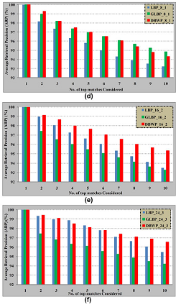
Results
Fig. : Comparison of proposed method (DBWP) with the other existing methods as a function of number of top matches considered on NEMA–CT database

Slide 21
CONCLUSIONS
A novel method employing DBWP operator is proposed for texture based biomedical image retrieval.
DBWP extracts the information from images using edges which are calculated by applying BWT on each bitplane of grayscale image.
Further, the features are extracted by performing LBP operation on each sub-band of BWT.
The effectiveness of the proposed method is tested by conducting two set of experiments for medical image retrieval thereby, significantly improving the performance in terms of their respective evaluation measures.

Slide 22
Thank You

